Slide 1

TCP Miscellaneous
  Mayank Pandey
  Motilal Nehru National Institute of Technology,
  Allahabad, Uttar Pradesh, India

Slide 2
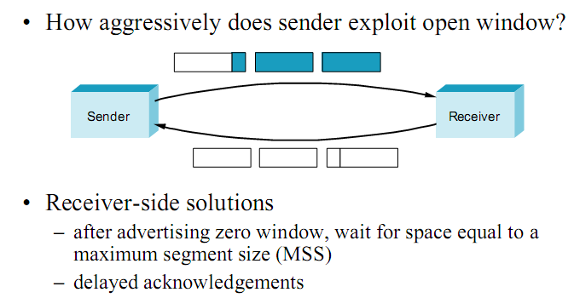
Silly Window Syndrome

Slide 3
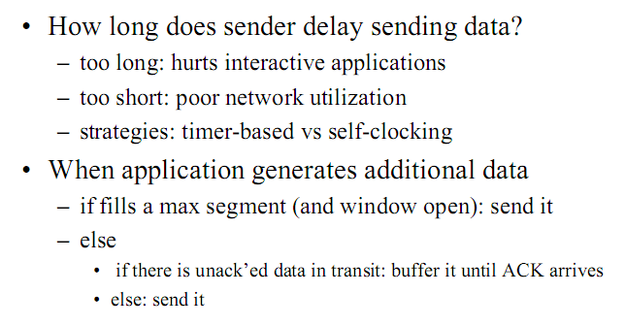
Nagle’s Algorithm

Slide 4
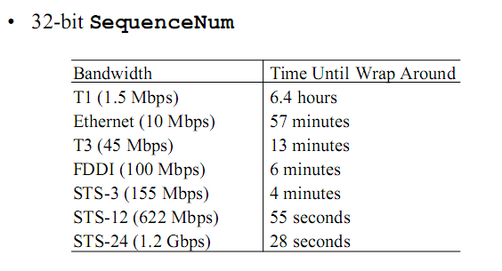
Protection against Wraparound

Slide 5
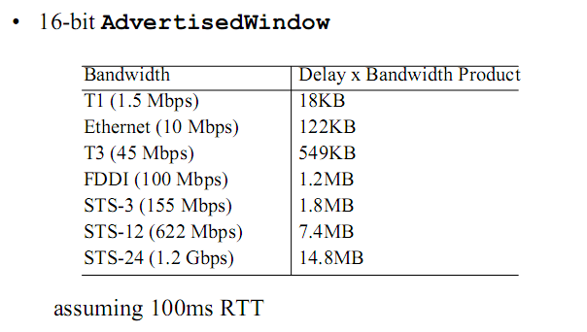
Keeping The Pipe Full

Slide 6
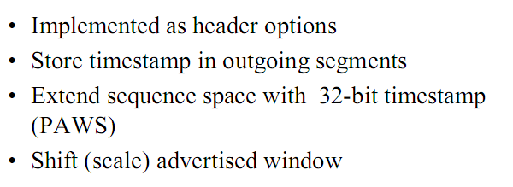
TCP Extensions

Slide 7
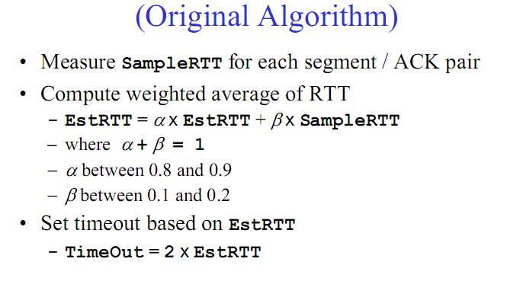
Adaptive Retransmission

Slide 8
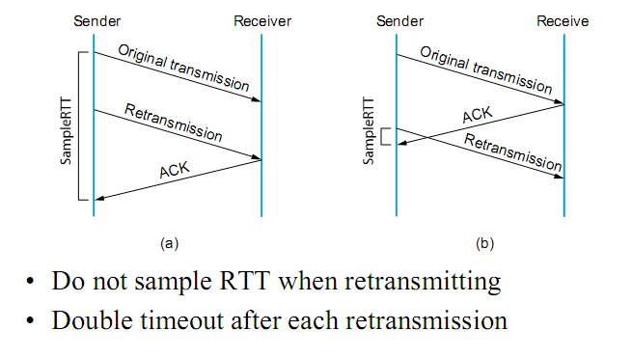
Karn/Partridge Algorithm

Slide 9
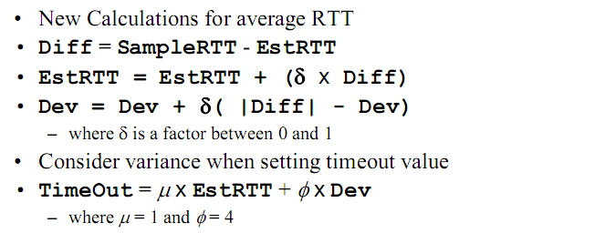
Jacobson/Karels Algorithm

Slide 10
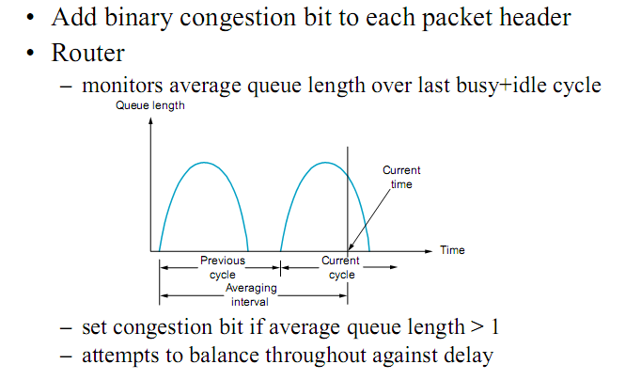
DecBit

Slide 11
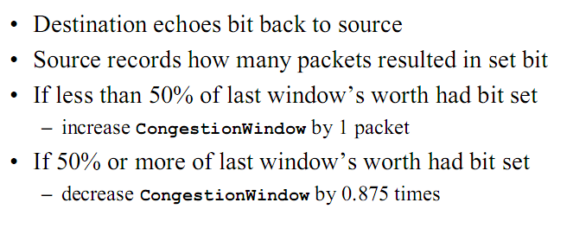
DecBit (Contd.)

Slide 12
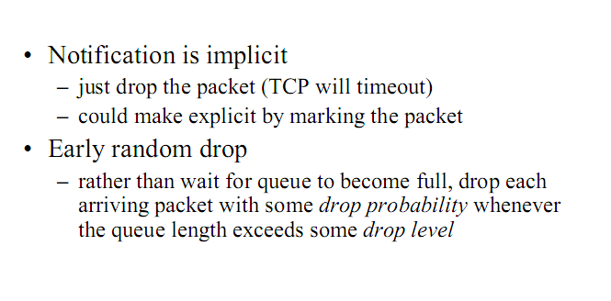
Random Early Detect (RED)

Slide 13
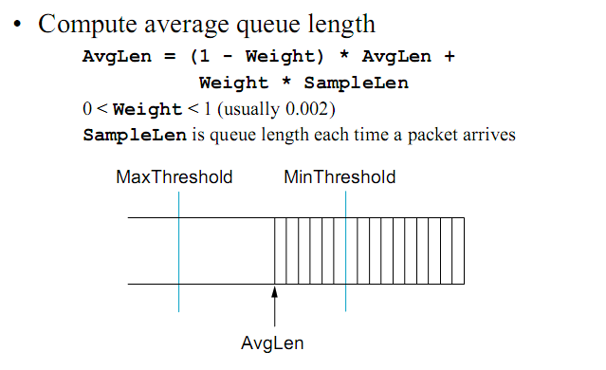
RED Details

Slide 14
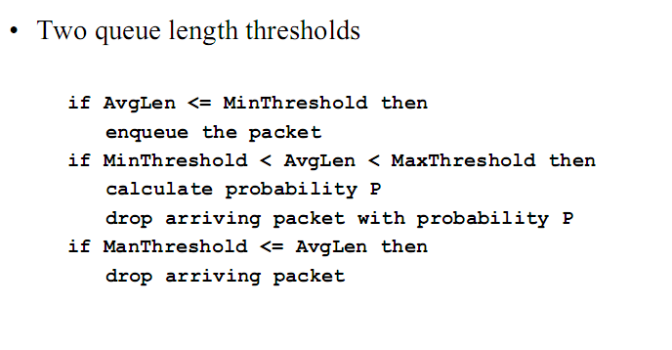
RED Details (Contd.)

Slide 15
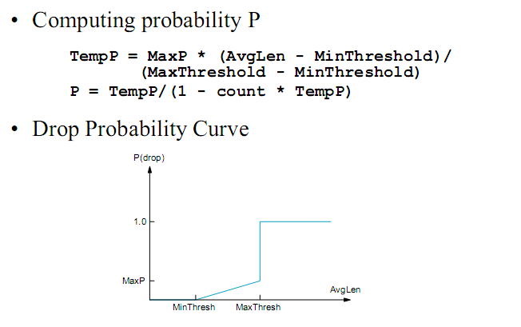
RED Details (Contd.)

Slide 16
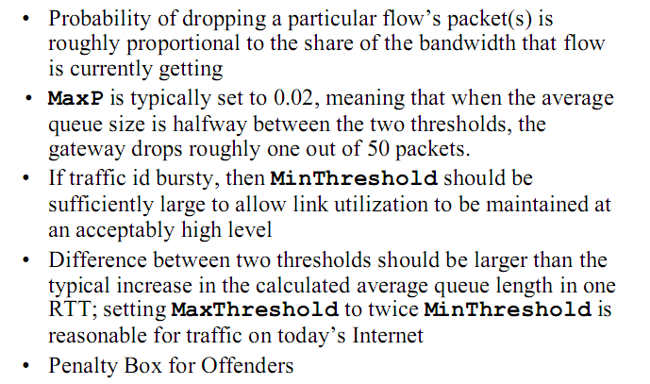
Tuning RED

